Slide 1
Force

Slide 2
Newton’s First Law
Law 1
when no force acts on a body, it will remain at rest or maintain uniform motion;
when a force is applied to a body, it will change its state of motion

Slide 3
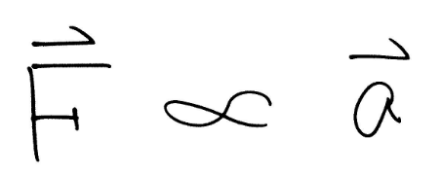
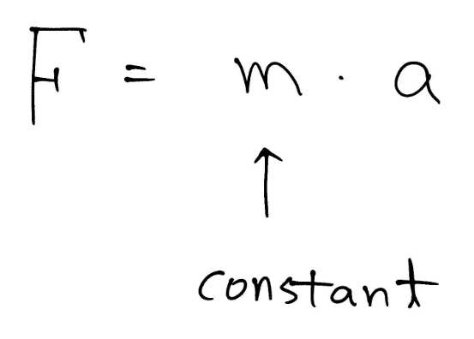
Force
Vector
Mass is different from weight

Slide 4
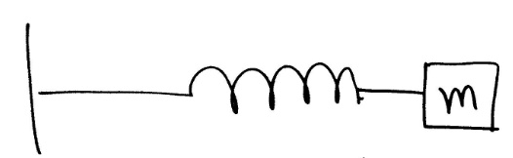
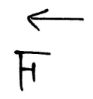
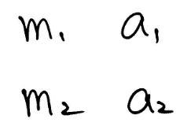
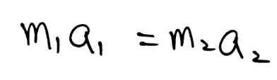
Same Force

Slide 5
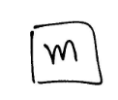
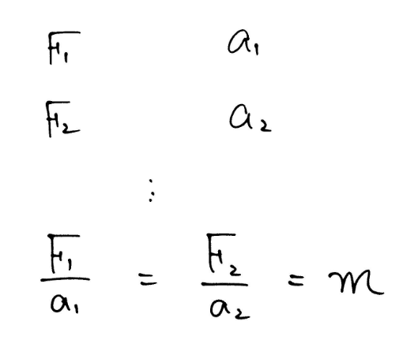
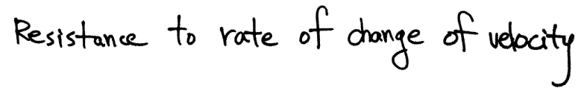
Same Mass
Newton’s 2nd Law
Mass is

Slide 6
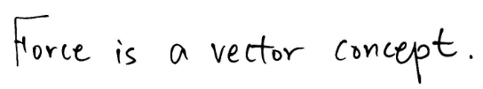
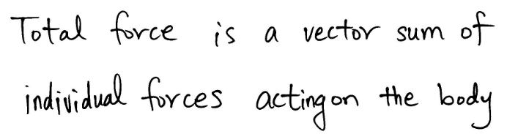
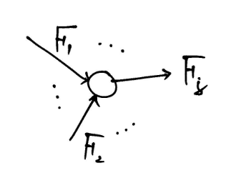
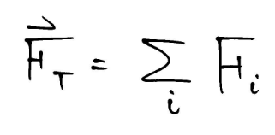
Free Body Force Diagram

Slide 7
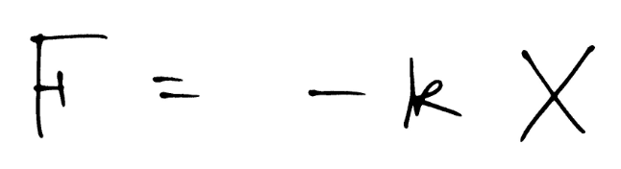
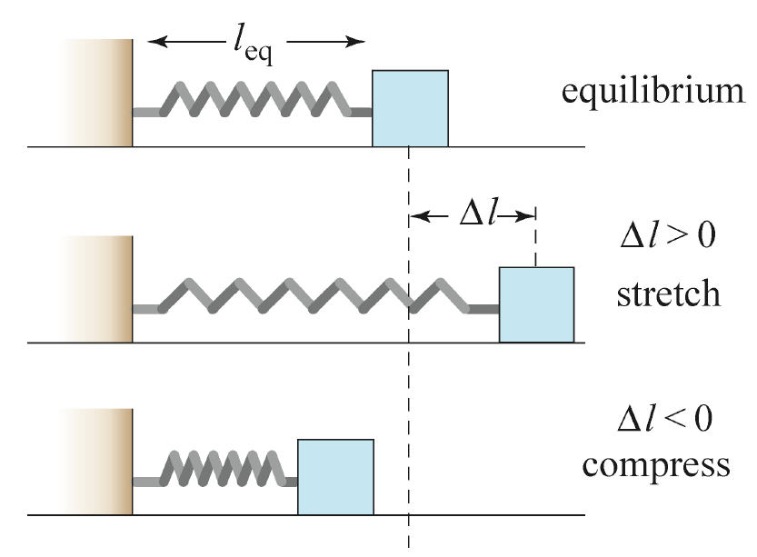
Spring Force

Slide 8
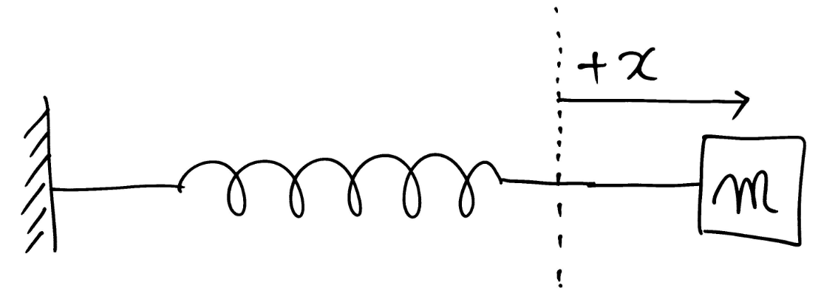

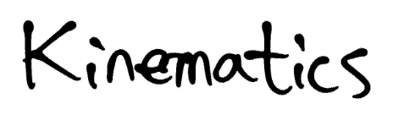
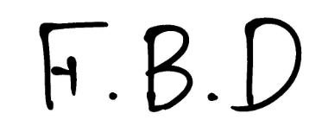
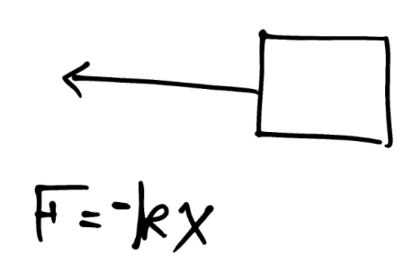
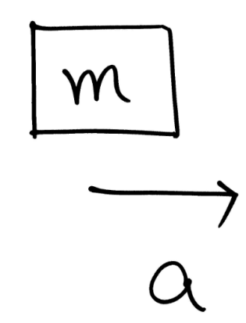
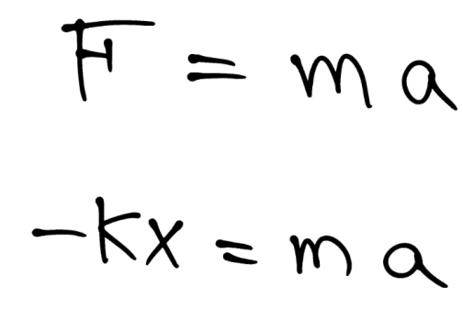
Spring Force

Slide 9
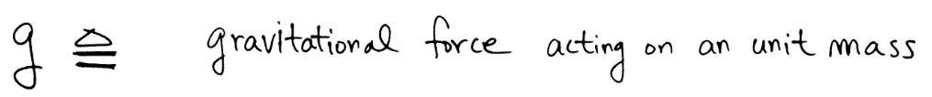
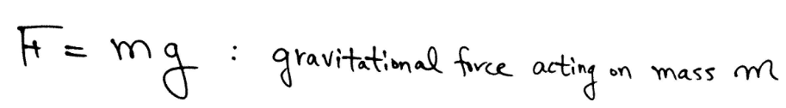
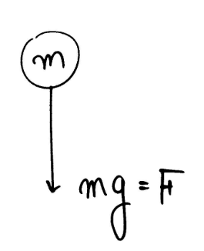

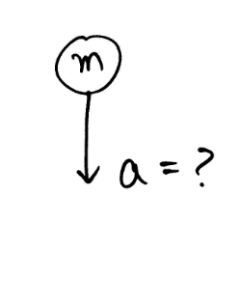
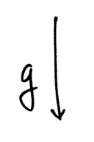
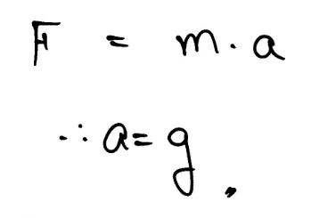
Gravitational Force Near the Earth

Slide 10


Newton’s Third Law: Action-Reaction Pairs
When two bodies interact via a force, then the force on one body is equal in magnitude and opposite in direction to the force acting on the other body

Slide 11
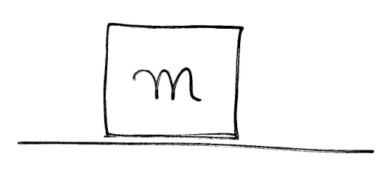
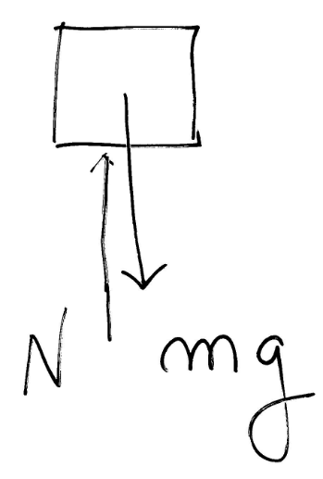

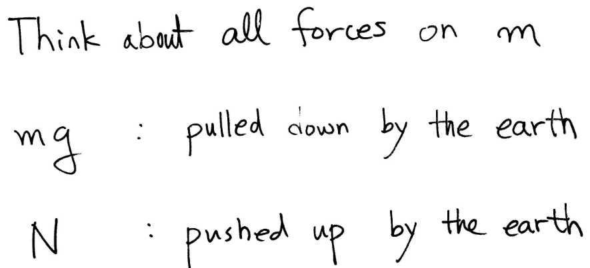
Example
F.B.D
m is at rest (a=0)
➔ No total external forces (N = mg)

Slide 12

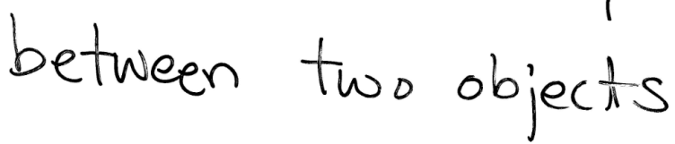
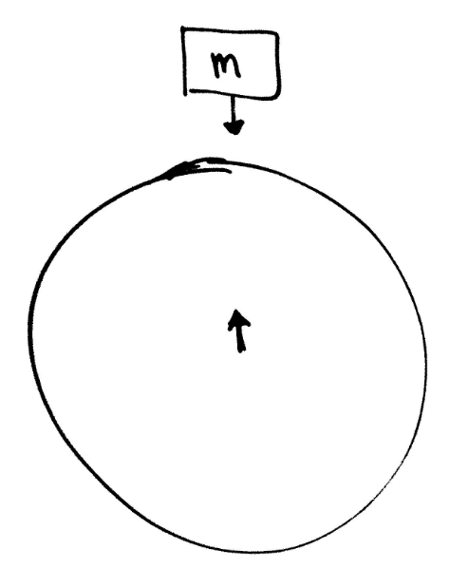
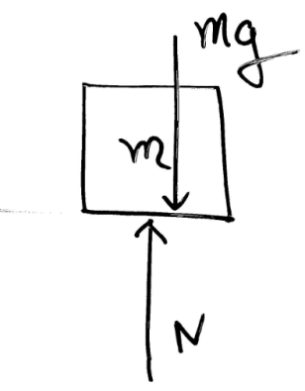
Action and Reaction

Slide 13
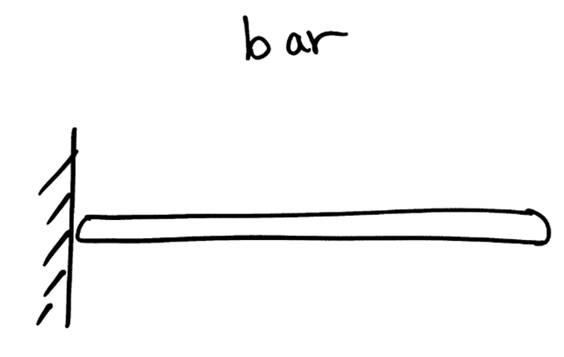
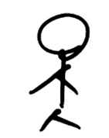

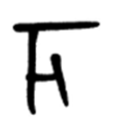
Example – Push

Slide 14
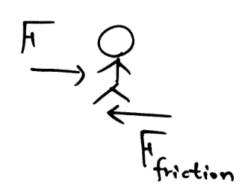


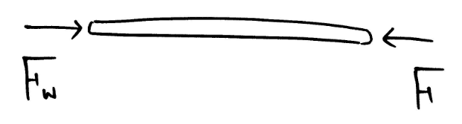

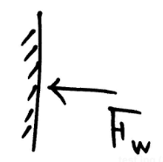
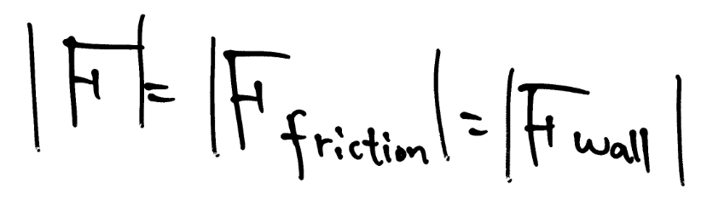
Example – Push

Slide 15
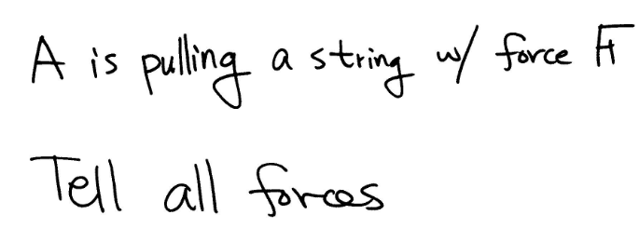
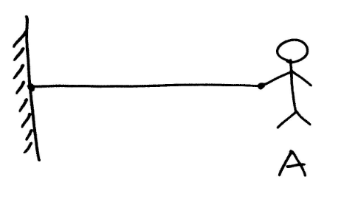
Example – Pull
F

Slide 16

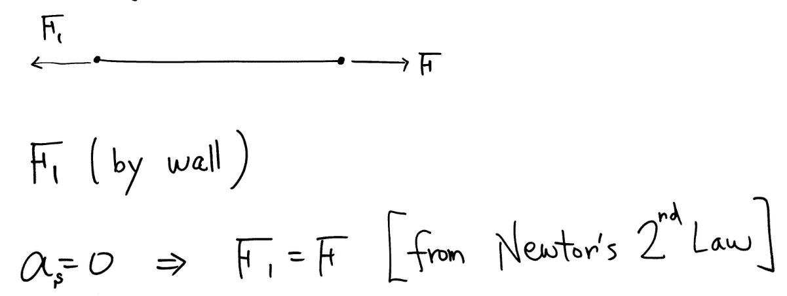
Example – Pull

Slide 17


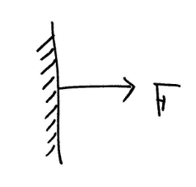
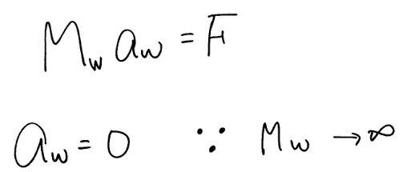
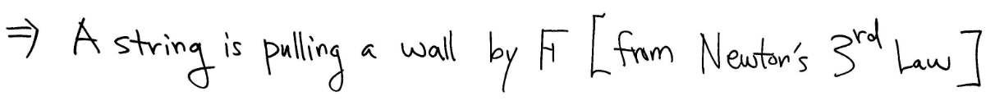
Example – Pull

Slide 18
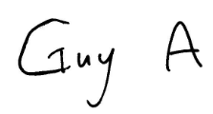
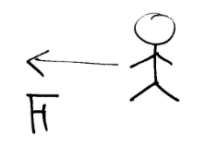
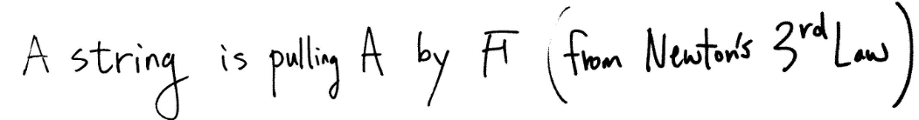
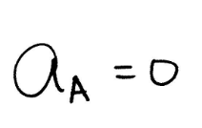



Example – Pull

Slide 19


Example – Inertial Reference Frame

Slide 20




Example – Inertial Reference Frame

Slide 21







Example – Non Inertial Reference Frame

Slide 22




Example – Non Inertial Reference Frame

Slide 23
Inertia and the Right Hand Turn
Many students of physics do not believe in centripetal ("inwards") forces. Even after completion of a thorough physics course, such students will still incorrectly believe that an object moving in a circle experiences an outward force
The car is turning to the right due to the inward force, yet you feel as though you are being forced leftward or outward. In actuality, the car is beginning its turning motion (to the right) while you continue in a straight line path.
http://www.physicsclassroom.com/mmedia/circmot/rht.cfm

Slide 24

What is Weight?

Slide 25







Weight

Slide 26



Weight

Slide 27









Example – Weight with an accelerated Elevator

Slide 28





Example – Weight Seen from an Accelerated Elevator

Slide 29

What is Weight in Tension?

Slide 30



Problems with Pulleys

Slide 31




Tension on a String is Uniform (?)

Slide 32


Example – Pulley

Slide 33

Example – Pulley

Slide 34


Example – Pulley

Slide 35

Force in a Circular Motion

Slide 36






Example – Inertial Circular Frame

Slide 37





Example – Non Inertial Circular Frame

Slide 38


Slide 39

Example

Slide 40

Example

Slide 41


Question

Slide 42
Question
Consider a car at rest on a level surface. We can conclude that the downward gravitational pull of Earth on the car and upward contact force of Earth on it are equal and opposite because
The two forces from an interaction pair
The net force on the car is zero
Neither of the above
Unsure

Slide 43

Question
A body of mass m is suspended from a spring with spring constant k in configuration (a) and the spring is stretched 0.1m. If two identical bodies of mass m/2 are suspended from a spring with the same spring constant k in configuration (b), how much will the spring stretch? Explain your answer.

